Slide 1
Novel packaging architecture for
Li-ion battery technology through licensing
Lowest cost, highest safety and highest energy density for two $100 billion emerging markets - electric vehicles and grid storage
Christina Lampe-Onnerud
Founder and CEO
Cadenza Innovation, Inc.
clo@cadenzainnovation.com
(617) 967-0885
www.cadenzainnovation.com

Slide 2
What do Duracell leadership want to hear?
The global lithium-ion energy storage market is predicted to be huge, US$18 – 60B in 2020 and presents a unique opportunity for the battery industry
Lithium-ion will dominate the energy storage industry for at least 10 years
Australia is the first market to take off, market is now booming!
  Industry analyst Sunwiz says 70 % of Australia's 1.6 million solar households are looking to install battery storage of some sort
  Profitable for a household to invest in storage due to termination of solar rebates and high electricity prizes
  32 home energy storage systems presently on the market
  Few global brands present, mostly new small companies
US market is currently dominated by grid storage systems
The Cadenza platform will enable a fast and low risk market entry
  Market leaders Tesla and LG Chem has been in the market for years
  New players must have an edge to succeed
2016-08-31: XXX
2017-02-20: XXX
2

Slide 3
Market Forecasts – 3rd party
Marking Cadenza TAM assumptions ( for auto and for grid)
Automotive
2020
2025
$25-30B
$34-49B
$30B
$175B
$281B
CIMB Malaysian
Bank (base)
Panasonic
CIMB Malaysian
Bank (bull)
SNE Research
Panasonic
CIMB Malaysian
Bank (base)
CIMB Malaysian
Bank (bull)
Utility Grid
2020
2025
2030
$18B
$60B
$95B
$160B
$400B
IHS
Panasonic
IHS
Panasonic
Citigroup

Slide 4
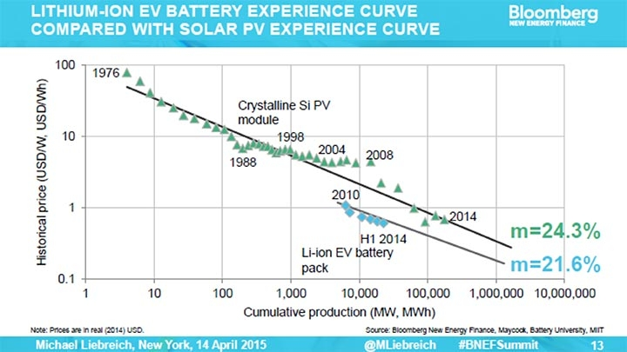
Electric Car Battery Costs Are Falling as Fast as Solar Panel Costs
Source: Bloomberg New Energy Finance, Maycock, Battery University, MIT
Retrieved: 2015-04-19 Bloomberg New Energy Finance http://www.bloomberg.com/news/articles/2015-04-16/big-oil-is-about-to-lose-control-of-the-auto-industry

Slide 5
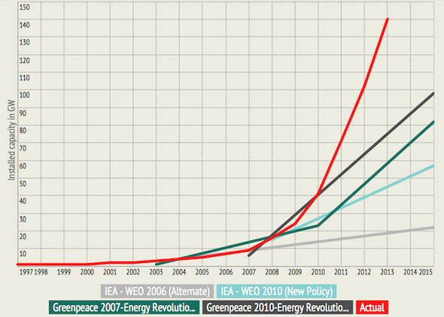
Solar PV Boom Underestimated by Nearly All
Cumulative installed solar PV capacity, Global
IEA – International Energy Agency http://www.iea.org/ WEO – World Economic Outlook by IMF International Monetary Fund http://www.imf.org/external/pubs/ft/weo/2015/update/01/ Greenpeace http://www.greenpeace.org/
Retrieved: 2015-04-14 RE New Economy 2015-03-31 http://reneweconomy.com.au/2015/graph-of-the-day-renewable-energy-boom-underestimated-by-nearly-all-45906

Slide 6
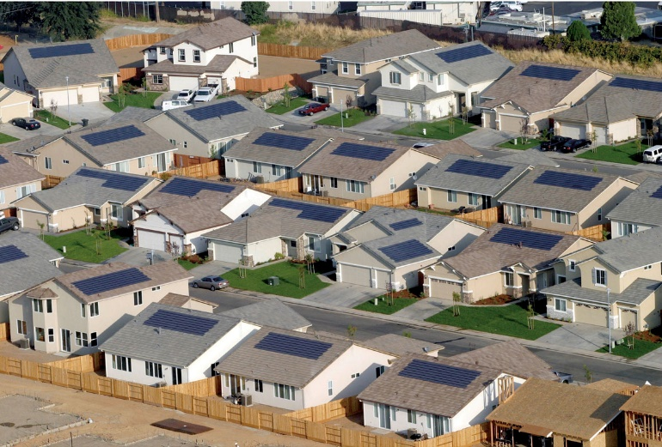
Australian home energy storage market
Industry analyst Sunwiz says 70 % of Australia's
1.6 million solar households are looking to
install battery storage of some sort
Forecasts for battery storage uptake include
2 million within a few years (Morgan Stanley)
and up to 6 million by 2030
(Bloomberg New Energy Finance)
CSIRO/ENA predicted that battery storage capacity would outstrip rooftop solar by 2025
2017-02-13: http://reneweconomy.com.au/lithium-ion-battery-storage-may-be-banned-inside-australian-homes-57002/
6

Slide 7
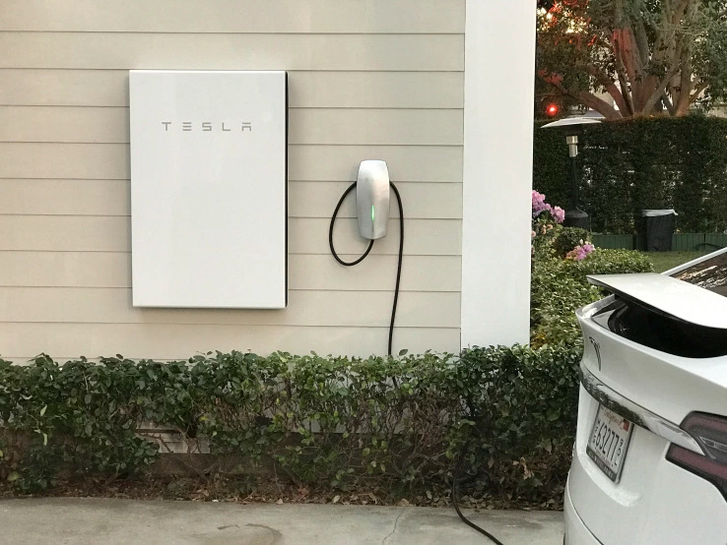
Players and chemistries used in the Australian market
The two biggest players in the market are Tesla
and LG Chem, both use lithium-ion batteries
Sonnenbatterie, Sony, GCL, BYD, Panasonic and
Samsung, also all use lithium-ion batteries
Enphase batteries use lithium iron phosphate
Australia’s Redflow use zinc bromine flow
batteries
Australia’s Ecoult use advanced lead batteries
US-based Aquion use saltwater batteries
2017-02-13: http://reneweconomy.com.au/lithium-ion-battery-storage-may-be-banned-inside-australian-homes-57002/
7

Slide 8
34 home energy storage systems now available on the Australian market
2017-03-08: https://www.solarquotes.com.au/battery-storage/comparison-table/
8

Slide 9
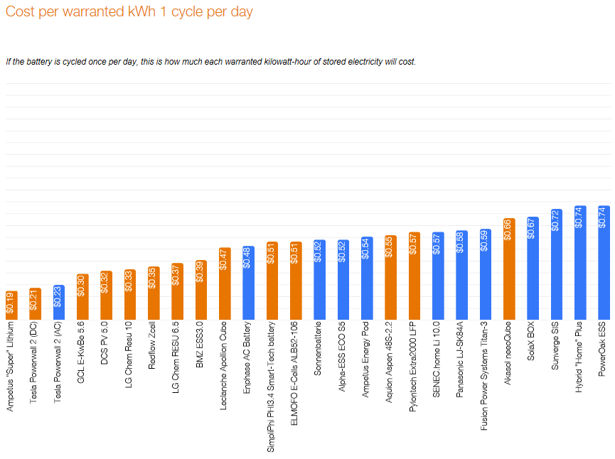
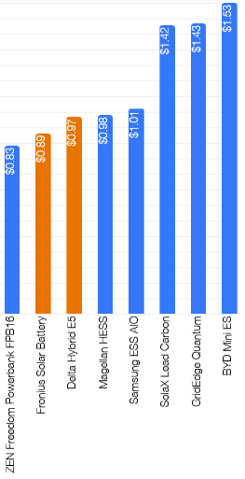

Cost per warranted kWh, 1 cycle per day
2017-02-15: https://www.solarquotes.com.au/battery-storage/comparison-table/
9

Slide 10
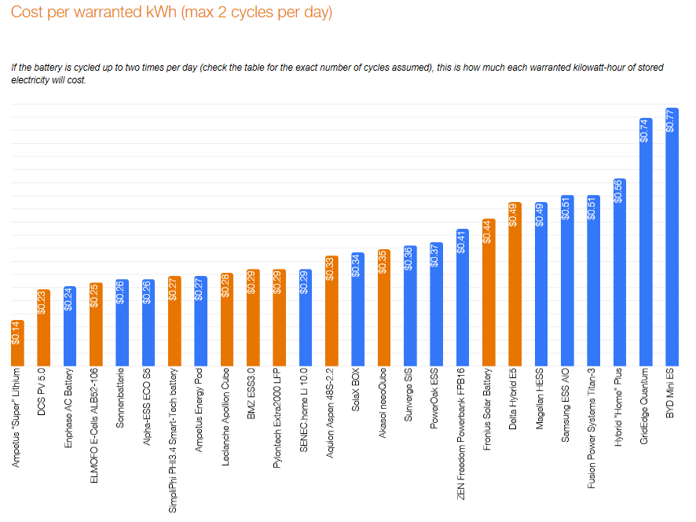
Cost per warranted kWh, max 2 cycle per day
2017-02-15: https://www.solarquotes.com.au/battery-storage/comparison-table/
10

Slide 11
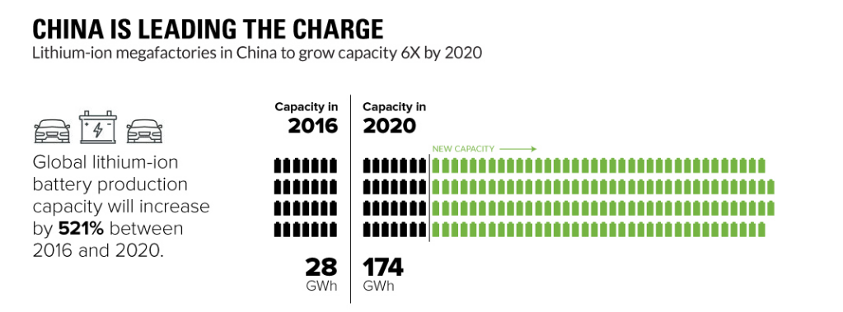

In 2020, with a battery module cost of US $160 per kWh, capacity is worth approx US $28B per year
2017-02-21: http://www.businessinsider.com/china-is-leading-the-charge-for-lithium-ion-factories-2017-2?r=US&IR=T&IR=T
11

Slide 12
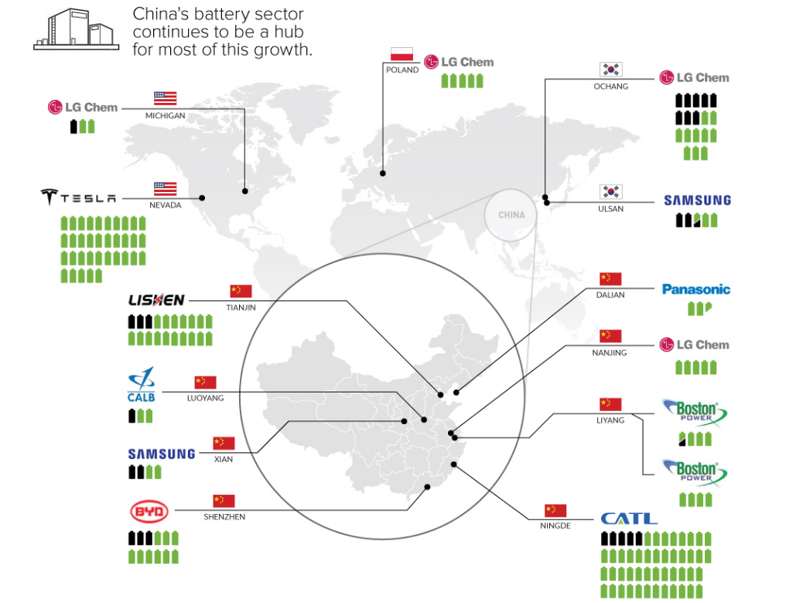
China’s battery sector continues to be a hub for most of this growth
2017-02-21: http://www.businessinsider.com/china-is-leading-the-charge-for-lithium-ion-factories-2017-2?r=US&IR=T&IR=T
12

Slide 13
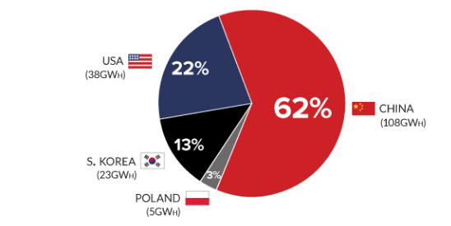
By 2020, mass production of lithium-ion batteries will be concentrated in just four countries
2017-02-21: http://www.businessinsider.com/china-is-leading-the-charge-for-lithium-ion-factories-2017-2?r=US&IR=T&IR=T
13

Slide 14
Foxconn to Build US $8.8 Billion Flat-Panel Screen Factory in China's Guangdong
Foxconn Chairman Terry Gou partnered with Guangdong Province officials for building a new flat-panel screen factory. The officials of the province said that the deal negotiation with Foxconn only took 50 days
Foxconn still hoping to build a $7 billion flat-panel plant in the U.S. as it welcomed pitches from state governments. "The U.S. must offer tax breaks and develop worker-training programs - and also study how things are done in China."
"We feel that if any state governments in the U.S. want to attract Foxconn, they should come here to learn and study. To see how in such a short span of time, we can get so many things done here," he added
2017-03-04: http://en.yibada.com/articles/197052/20170304/foxconn-to-build-an-8-8-billion-flat-panel-screen-factory-in-guangdong-province.htm
14

Slide 15
Reuters: China, Europe drive shift to electric cars as U.S. lags
Industry executives in Detroit said hitting the brakes on electric vehicles in the United States would not relieve the pressure to bring them to market, because China and Europe are forging ahead with policies to expand sales of plug-in cars
Ford is moving forward with previously announced plans to invest $4.5 billion for plug-in vehicles by 2020, Chief Executive Mark Fields said earlier this month. "The industry is changing, the infrastructure's starting to build, and that's why our view is that within the next 15 years we'll see more electrified offerings … than we'll see gasoline-powered," Fields said as he unveiled a $700 million plan to build a battery SUV and other plug-in vehicles in Flat Rock, Michigan
"Car electrification is an irreversible trend," said Jacques Aschenbroich, chief executive of auto supplier Valeo
2017-01-15: http://www.reuters.com/article/us-usa-autoshow-electrics-analysis-idUSKBN14Z0KW
15

Slide 16
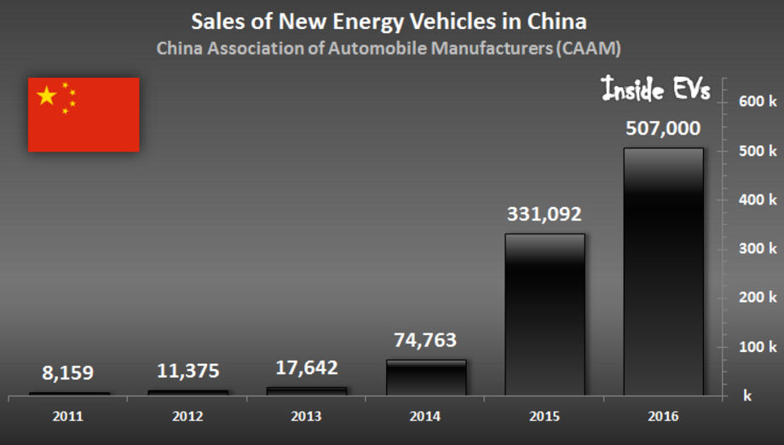
China has set a goal of 5,000,000 electric and plug-in cars on the road by 2020
After record a 507,000 plug-in vehicles sold in 2016 (including more than 350,000 cars and 115,700 all-electric buses), the new goal is 800,000 for 2017
By 2025, the government wants plug-in vehicles sold to rise to 3,000,000 vehicles a year
2016-08-31: https://cleantechnica.com/2016/08/31/china-plans-get-rid-hundreds-electric-car-startups/
2017-02-20: http://insideevs.com/china-targets-800000-plug-in-electric-vehicle-sales-in-2017/
16

Slide 17
US Does Not Have a Formal Energy Policy But Instead a Focus on 3 Goals—Secure Supply, Keep Costs Low & Protect Environment (Congressional Rsrch Service)
Government programs developed to improve energy efficiency and encourage conservation, increase domestic production of conventional sources and increase new sources including renewable sources (eg, hydro, solar, wind). (CRS study)
Underlying debate in US on energy is role of government—some see government intervention as positive and some who see it as a necessary evil to be restricted. (CRS Study) Related debate is on causes and responses to climate change.
US energy policy and programs are diffuse through 50 states and federal government. Example: 29 states have required renewable energy portfolios standards (RPS) for local utilities; 7 states--voluntary RPS; remainder--none. (ELI)
Key example of state/fed roles: CA led the way on much higher CAFE fleet fuel standards for all auto OEMs selling in CA; adopted by federal government in 2011 with industry support.
US federal policy encourages new green energy technologies (eg DOE loans/grants) (ELI)
Retrieved: 2015-03-08 Congressional Research Service (“CRS”) report: Energy Policy: 114th Congress Issues. 5 Jan 2015.; Environmental Law Institute (“ELI”) “Why the United States Does Not Have a Renewable Energy Policy”. By E. Donald Elliott. 43 ELR 10095 2-2013.

Slide 18
US Energy Information Admin: China’s Population and Fast-growing Economy has led it to be the Largest Energy Consumer and Producer in the World
China is the world's second-largest oil consumer behind the United States and became the largest global energy consumer in 2010.
China's oil consumption growth accounted for one-third of the world's oil consumption growth in 2013, and EIA projects the same share in 2014.
China is the largest producer and consumer of coal in the world and accounts for almost half of the world's coal consumption. Coal supplied 69% of China’s energy consumption in 2011, oil 18%, hydro 6%, natural gas 4%, nuclear almost 1%, other renewables 1%.
In the energy sector, the government is moving toward more market-based pricing schemes, energy efficiency measures, and competition among energy firms, as well as making greater investments in upstream hydrocarbon plays and renewable energy projects.
China has a goal to produce at least 15% of overall energy output by 2020 from renewable energy sources as the government aims to address environmental issues. Chinese companies invested $65 billion in renewable energy projects in 2012. China is encouraging investment in renewable energy and accompanying transmission infrastructure through a variety of financial and economic incentives.
Retrieved: 2015-03-08 EIA China Country Report http://www.eia.gov/countries/cab.cfm?fips=ch

Slide 19
China Energy Policy: Effort to Increase Use of Market, Increase Renewable Energy to 15% by 2020
In the energy sector, the government is moving toward more market-based pricing schemes, energy efficiency measures, and competition among energy firms, as well as making greater investments in upstream hydrocarbon plays and renewable energy projects. (EIA China Rpt)
China has a goal to produce at least 15% of overall energy output by 2020 from renewable energy sources as the government aims to address environmental issues. (EIA)
Chinese companies invested $65 billion in renewable energy projects in 2012--fully 30% of the total investment by the G-20, including 25% ($31.2 billion USD) of global solar energy investment, 37% percent ($27.2 billion USD) of global wind energy investment, and 47% ($6.3 billion USD) of global investment in "other renewable energy" (small hydro, geothermal, marine, and biomass) (Pew Trust—Who’s Winning Clean Energy Race 2012)
Chinese policy is premised on an understanding of the gravity of the country’s energy and environmental woes. Beijing is confronting these with a sense of urgency. (Paulson Inst.) Recent release of critical film on Chinese air pollution/lack of government enforcement and removal days later from internet suggests internal govt. disagreement at senior level on extent of permitted public criticism and comment on environmental issues.
Retrieved: 2015-03-07 EIA China Country Report http://www.eia.gov/countries/cab.cfm?fips=ch
Who’s Winning the Clean Energy Race, 2012 Edition, Pew Trust, pg 7; Rebalancing China’s Energy Strategy, January 2015, Paulson Institute http://www.pewtrusts.org/en/research-and-analysis/reports/2013/04/17/whos-winning-the-clean-energy-race-2012-edition http://www.paulsoninstitute.org/media/162075/ppee_rebalancing_china_s_energy_strategy_ma_english.pdf

Slide 20
Significant examples of energy storage related capital deployed globally
VW to invest up to US$ 15.5 billion in a major new battery
Ford is investing US$ 4.5 billion to add 13 electrified vehicles
Mercedes-Benz to electrify all model series in US$ 7.8 billion R&D investment
Total purchased battery maker Saft for US$ 1.1 billion
Apple offers US$ 1.8 billion for McLaren Technology Group (EV knowledge)
Syrah Resources raised US$146 million in capital to open worlds largest graphite mine
2016-08-17 http://www.greentechmedia.com/articles/read/what-the-oil-and-gas-supermajors-can-learn-from-totals-battery-buy
2016-06-13 http://www.electric-vehiclenews.com/2016/06/mercedes-benz-to-electrify-all-model.html
2016-09-22 http://www.electric-vehiclenews.com/2016/09/apple-offers-25b-for-mclaren-technology.html
2016-06-15 http://electriccarsreport.com/2016/06/ford-introduce-13-electrified-vehicles-2020/?utm_source=dlvr.it&utm_medium=twitter
2016-06-01 http://www.greentechmedia.com/articles/read/volkswagen-is-planning-its-own-battery-gigafactory-to-support-1-million-ele?utm_source=feedburner&utm_medium=feed&utm_campaign=Feed%3A+GreentechMedia+%28Greentech+Media%29
2017-03-10: http://www.syrahresources.com.au/application/third_party/ckfinder/userfiles/files/December%202016%20New%20York%20Investor%20Presentation-13Dec16.pdf
20

Slide 21
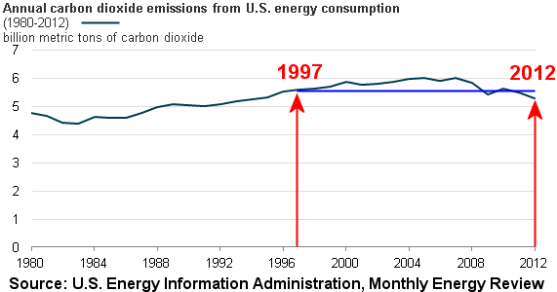
USA inadvertently meets 1997 Kyoto protocol on CO2 emission reductions without ever signing on thanks to a stagnant economy
2015
2013-04-15: https://wattsupwiththat.com/2013/04/05/usa-meets-kyoto-protocol-without-ever-embracing-it/
2016-05-09: https://www.eia.gov/todayinenergy/detail.php?id=26152
21

Slide 22
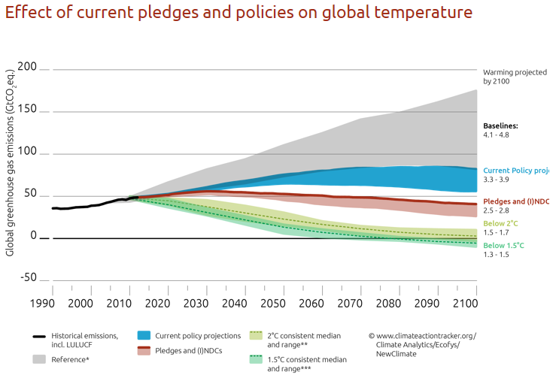
In the absence of policies, global warming is expected to reach 4.1 °C – 4.8 °C above pre-industrial by the end of the century
2017-03-10: http://climateactiontracker.org/global.html
22

Slide 23
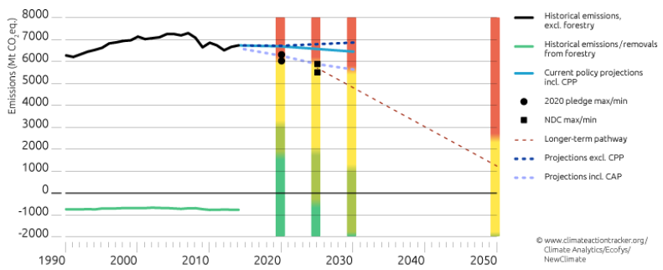
The US would have to fully implement the Clean Power Plan and the Obama Administration’s Climate Action Plan if it is to meet its 2025 Paris Agreement
2017-03-10: http://climateactiontracker.org/global.html
23

Slide 24
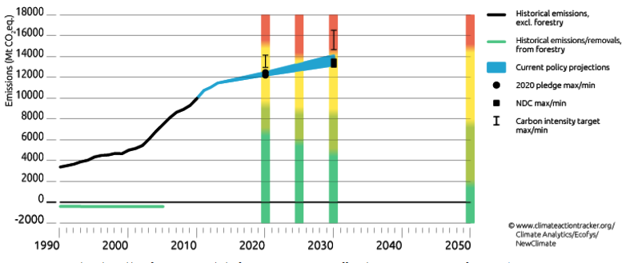
China is on track to peak its carbon dioxide emissions between 2025 and 2030
2017-03-10: http://climateactiontracker.org/global.html
24

